Slide 1
Project Management
Assignment2

Slide 2
Smart House
The aim of our Project: With this Project; everybody can control their own home remotely,provide digital security and increase efficiency in individual works.
Scope: We aim to create market on East Middle and in Turkey and especially to construct companies which sells luxury homes. Furthermore, experts of their own field will work with us.
Our total budget is 2,412,640 TL

Slide 3
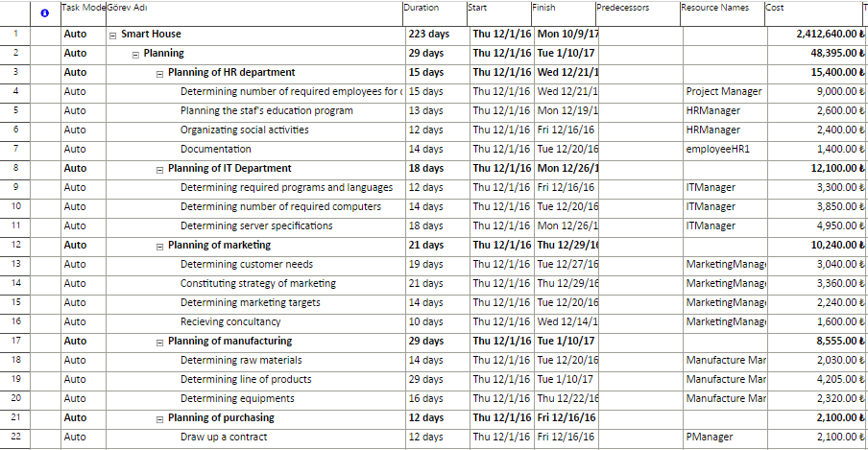
Plannıng

Slide 4
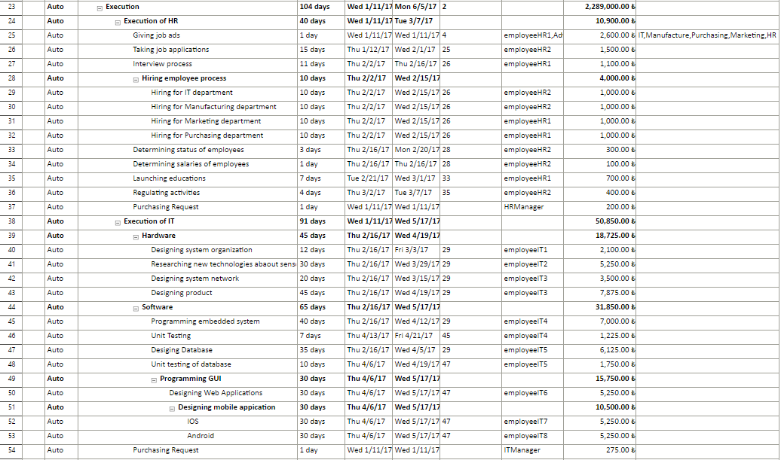
Execution

Slide 5
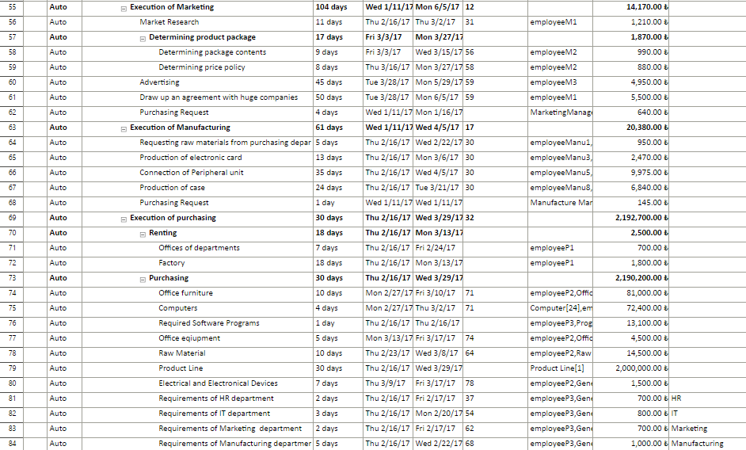
Execution

Slide 6
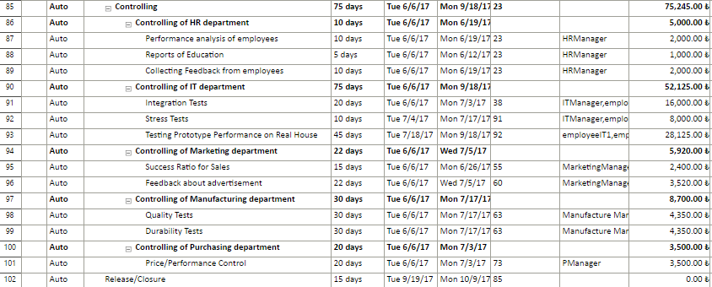
Control

Slide 7
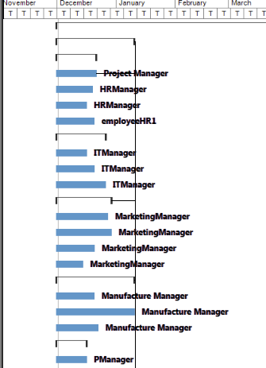

Slide 8
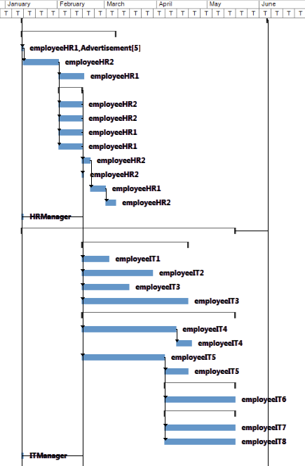

Slide 9
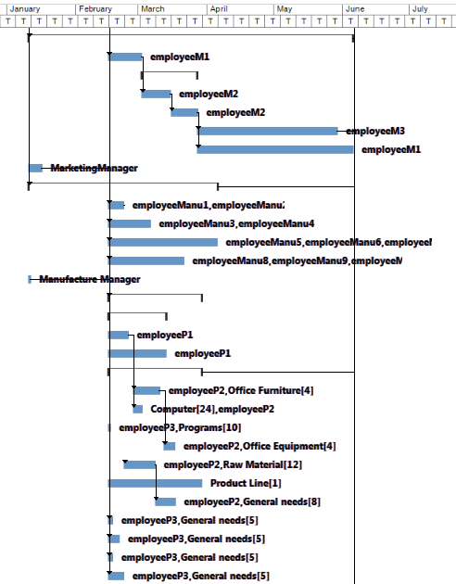

Slide 10
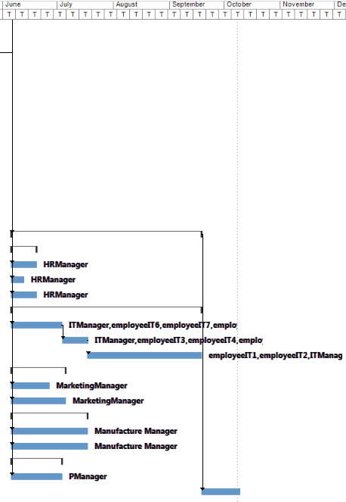

Slide 11
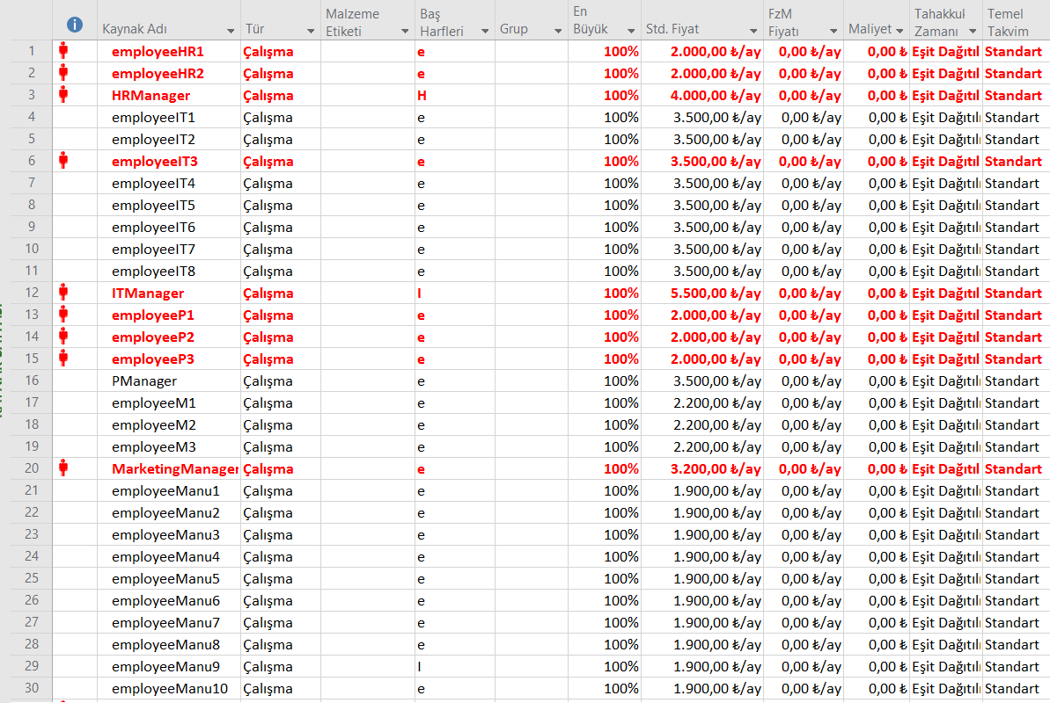
Employees

Slide 12
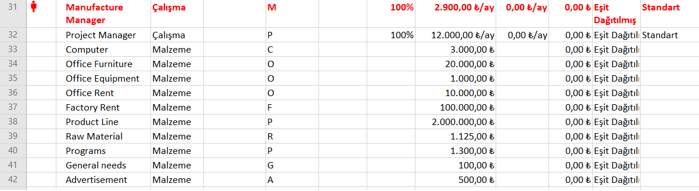
Resources

Slide 13
Departments | Budget
Human Resource (HR) |  |  | -2000 TL
Purchasing |  | HR | 700 TL
Purchasing |  | IT | 800 TL
Purchasing |  | Marketing | 700 TL
Purchasing |  | Manufacturing | 1000TL+2.000.000 TL
Total Purchasing |  |  | 2.003.200 TL
HR | 50.000 TL |  | 31.300+700-2000 TL | +20.000 TL
IT | 110.000 TL |  | 115.075+800+500 TL | -6.375 TL
Marketing | 55.000 TL |  | 30.330+700+500 TL | +23.470 TL
Manufacturing | 2.000.000 |  | 37.635+2.001.000+500 TL | -39.135 TL
Purchasing | 200.000 TL |  | 2.198.300+500-2.003.200 TL | +4.400 TL

Slide 14
Group Members
040140818 Handan ÇEVİK
150130055 Kağan ÖZGÜN
150120109 Mustafa GÖK
150130052 Emre ERDOĞAN
150130802 Firdevs CANLI

